Slide 1



Power Bi project
View in Power BI
Last data refresh:
18-04-2023 07:14:52 UTC
Downloaded at:
26-04-2023 03:11:03 UTC

Slide 2
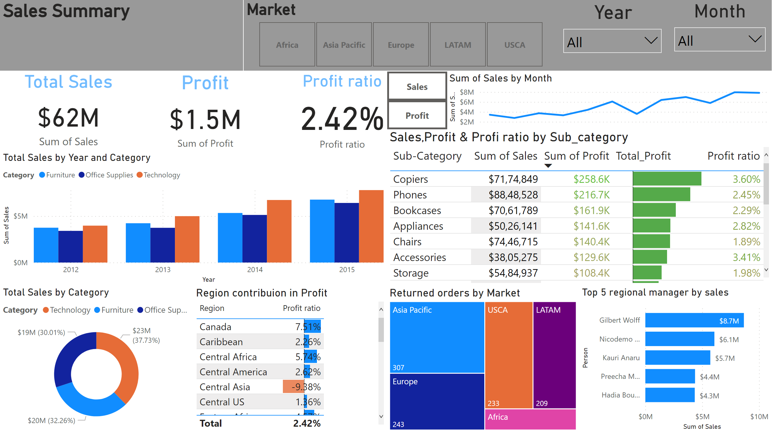
Page 1
Notes:
Sales Summary
No alt text provided
Market
No alt text provided
lineChart
No alt text provided
lineChart
No alt text provided
actionButton
No alt text provided
Returned orders by Market
No alt text provided
Region contribuion in Profit
No alt text provided
Total Sales by Category
No alt text provided
Total Sales by Year and Category
No alt text provided
Profit ratio
No alt text provided
Profit
No alt text provided
Total Sales
No alt text provided
Month
No alt text provided
Year
No alt text provided
actionButton
No alt text provided
Sales,Profit & Profi ratio by Sub_category
No alt text provided
Top 5 regional manager by sales
No alt text provided

